Slide 1
Recommendation Systems
Ryan Wedoff & Zongsheng Sun
Stewart Group 3

Slide 2
Recommendation Systems: General Idea
Many companies and services recommend new products or ideas based on what you have previously rated, liked, or looked at
Ex:
Amazon
Netflix
Google

Slide 3
What did we do?
We created a movie recommendation system similar to Netflix
Data From:
F. Maxwell Harper and Joseph A. Konstan. 2015. The MovieLens Datasets: History and Context. ACM Transactions on Interactive Intelligent Systems (TiiS) 5, 4, Article 19 (December 2015), 19 pages. DOI=http://dx.doi.org/10.1145/2827872

Slide 4
Method Used
Data Format
Movie
 |  |  | Rating |  |  | Rating
 | Rating
 |  | Rating |  |  | Rating
 | Rating |  |  |  |  |  | Rating
We started with a Sparse Matrix of Users X Movies
User

Slide 5
Method Used
SVD
Movie
 |  |  | Rating |  |  | Rating
 | Rating
 |  | Rating |  |  | Rating
 | Rating |  |  |  |  |  | Rating
We took the Singular Value Decomposition of this sparse matrix
User

Slide 6
Method Used
Other Additions
Movie
 |  |  | Rating |  |  | Rating
 | Rating
 |  | Rating |  |  | Rating
 | Rating |  |  |  |  |  | Rating
Avg = Average Rating per movie
Aer = Exceed Average Rate for each user
User

Slide 7
Method Used
Final Prediction
Movie
 |  |  | Rating |  |  | Rating
 | Rating
 |  | Rating |  |  | Rating
 | Rating |  |  |  |  |  | Rating
Final = Avg + aer[chosen_row] +svd[chosen_row]
Svd[chosen_row]
Left singular vectors * diagonal of the singular values * transpose of right singular values
User

Slide 8
What did we end up with?
A list containing the ratings for each of the movies
We sorted the list and kept the index (the index represented the movie_id)
We gave the top 10 “recommended movies”

Slide 9
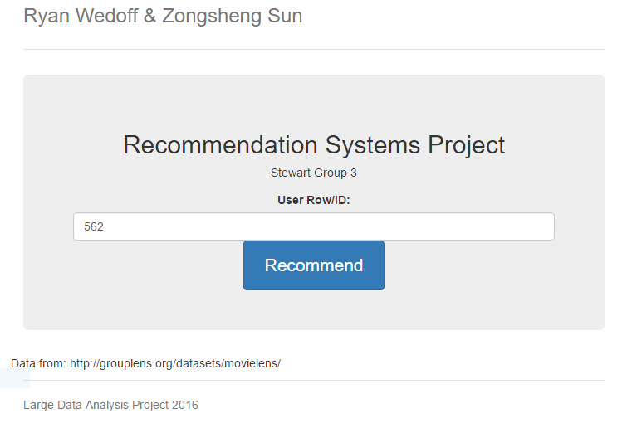
What did we Create
We created a demo Web App that takes a UserID and then gives Movie Recommendations.
The computation is done only once, and the results are saved so the user does not need to wait for the large data computations to be done.
Notes:
Do a demonstration here!

Slide 10
Testing
The Movie Lens Data come broken up into a test and base data set
We calculated recommendations for every user using the 100,000 rating set
Calculated standard deviation to determine how well our predictions were.
RESULTS:
Insert number here….

Slide 11
Observations
100,000 Rating set was too small!
2 people rated Santa with Muscles (Movie_id: 1500) a 5 out of 5!
Because our model takes in account how well rated a movie is in general, the model believes that Santa with Muscles is the greatest movie ever and everyone should watch it!
Santa with Muscles got a 2.4/10 on IMDB.
Solution? Bigger Data Set
20,000,000 Rating set was too big!
My laptop froze and then ran out of memory when trying to compute predictions for the 20,000,000 rating data set.
Solution? Try a more powerful computer, use a GPU?

Slide 12
Observations
1,000,000 Rating set took a long time
This data set took a long time to process, but it made it through my computer after some time.
???

Slide 13
Questions?
Thanks for listening!

